Slide 1

Deep Data Hackathon 2.0
Team Name: TriByte
“Turning Data into Decisions for a Resilient Planet”
Problem Statement: Global Climate Change
Team Members:
Deepika Gupta (2301730274)
Vishu Sehgal (2301730276)
Akshita Sharma (2301730278)

Slide 2
WHY CLIMATE CHANGE & DATA MATTERS
Global warming is accelerating and affecting billions of people.
Countries face rising CO₂ emissions, sea level rise, and extreme weather.
Governments need evidence-based policies to respond effectively.
Data helps us uncover patterns → guiding real-world climate solutions.

Slide 3
THE CLIMATE CHALLENGE
Global average temperatures are rising every decade.
CO₂ emissions continue to grow, especially in industrial nations.
Sea levels are rising, threatening coastal & island nations.
Extreme weather events are becoming more frequent & intense.
Deforestation reduces Earth’s ability to absorb carbon.
The world needs data-driven policies to address these challenges.

Slide 4
APPROACH
Data Cleaning & Preparation – handled missing values, outliers, and duplicates.
Exploratory Data Analysis (EDA) – studied temperature, CO₂, rainfall, sea level, renewables, forest area, etc.
Visualization & Dashboard – created clear visuals and interactive views in Power BI.
Insight Generation – identified patterns, correlations, and success stories.
Policy Recommendations – converted findings into actionable solutions for governments.

Slide 5
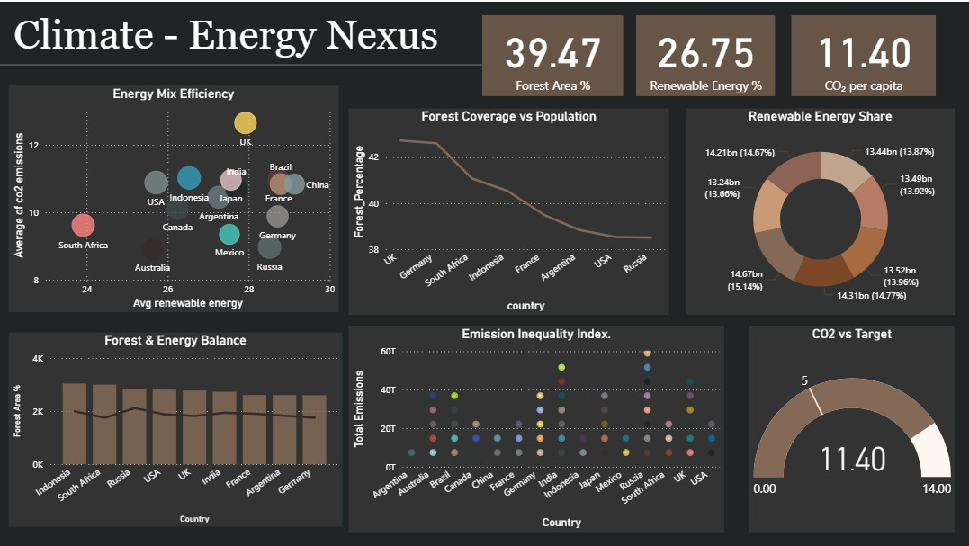
INTERACTIVE DASHBOARD IN POWER BI

Slide 6
KEY INSIGHTS & RECOMMENDATION
KEY INSIGHTS
Global avg. temperature has risen by ~1.2°C since 1900.
Top 10 countries = 70% of CO₂ emissions.
Sea levels rising steadily, threatening coastal nations.
Countries with higher forest cover show relatively lower emissions growth.
Renewable energy adoption correlates with reduced CO₂ intensity.
RECOMMENDATION
Accelerate Renewable Energy investments in high-emission nations.
Reforestation programs to absorb more carbon.
Disaster preparedness funding for vulnerable countries.
Data-driven monitoring with dashboards for real-time climate action.

